Slide 1
Chinook Music Sales Analysis and Strategic Recommendations
By Abhilash Kukade

Slide 2
Business Challenge
Chinook, a music retailer, wants to better understand their customers and sales trends to grow in the physical music market.
As their data analyst, your role is to uncover key behaviors, sales drivers, and regional preferences using historical sales data.

Slide 3
Data Landscape
Key Tables: album, artist, customer, genre, invoice, invoice_line, track, playlist
Topics Covered: Revenue, Genre Trends, Customer Churn, Market Segmentation, CLV
Geographic Focus: Primarily USA, with global comparisons

Slide 4
Data Landscape
Before diving into insights, it’s essential to understand how Chinook’s data is structured. The schema diagram on the next slide illustrates how key entities relate to one another:
customer ➝ linked to invoice
invoice ➝ connected to invoice_line
invoice_line ➝ joined with track
track ➝ linked to album, artist, and genre
This relationship model forms the foundation for analyzing purchases, genres, and customer behavior.

Slide 5
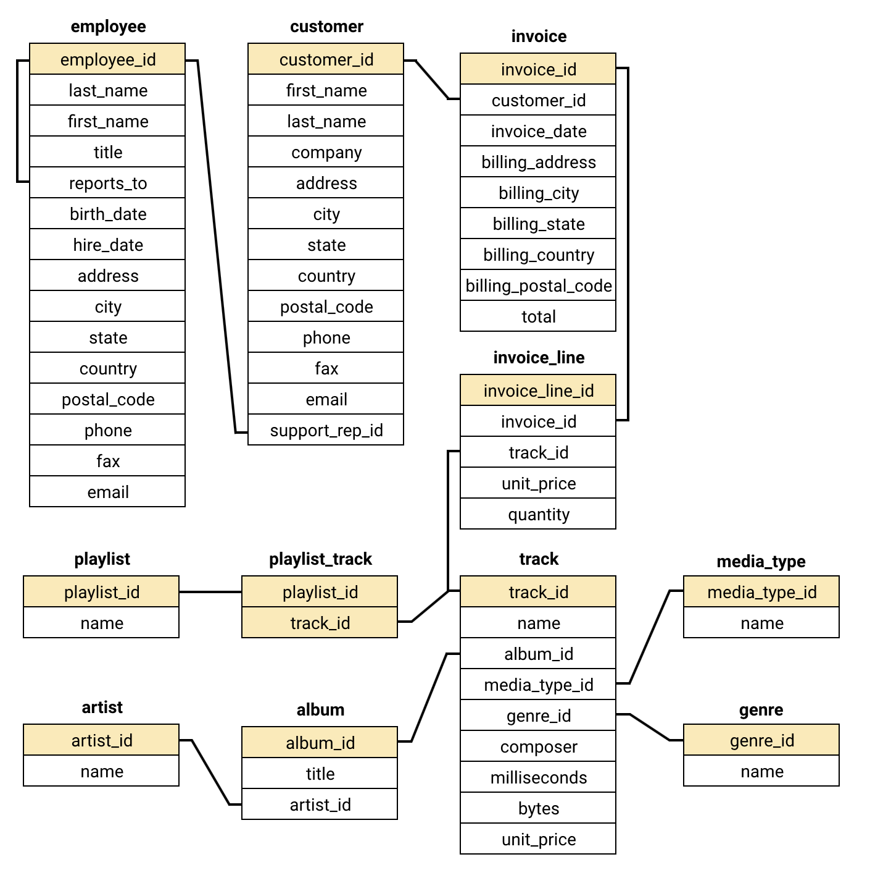
Data Modeling – Table Relationships

Slide 6
Sales Spotlight – What Are People Buying?
Focused on track and artist-level sales in the USA market
Identified that Rock and Alternative genres dominated overall sales
Artists like Jimi Hendrix, Nirvana, and Cake consistently appeared as top performers
These genres and artists significantly influenced revenue trends

Slide 7
Who Are Chinook’s Customers?
Majority of customers located in the USA and Canada
Slight demographic skew toward male buyers
Most spending came from a smaller, more engaged customer segment
Indicates potential for high-value retention and personalization strategies

Slide 8
Where Is the Money Coming From?
Highest revenue contributors: USA, Canada, and Brazil
France and Germany showed high average spend per customer
Combination of volume markets and high-value regional segments
Guides resource allocation by region

Slide 9
Customer Value – Loyalty vs. Churn
Long-term customers purchased more frequently
These customers had 3x higher lifetime value than new ones
Churn rate identified at only 1.7% in the past 3 months
Highlights strong potential for retention-driven growth

Slide 10
Customer Purchasing Behavior – Revenue & Purchase Frequency
Key Insights
Purchase Frequency ▸ Long-Term: 600 orders ▸ New: 14 orders → High retention among long-term users
Revenue Contribution ▸ Long-Term: $4,605.48 (~97% of total) ▸ New: $103.95 → Loyal users are the primary revenue drivers

Slide 11
Customer Value Metrics – AOV & Basket Size
Customer Behavior
AOV: ▸ Long-Term: $7.68 ▸ New: $7.43 → Slightly higher among loyal users
Basket Size: ▸ Long-Term: $7.68 ▸ New: $7.43 → Shows more trust & exploration from loyal customers

Slide 12
Regional Market Overview
Key Patterns
USA & Canada: High revenue, strong retention
Germany & India: High avg. order value, but fewer purchases
Brazil: Moderate revenue, needs engagement boost

Slide 13
Regional Churn Analysis
Takeaways:
Stable Markets: USA, Canada
→ Upsell opportunities
High Churn Zones: Germany, Brazil, India
→ Need retention strategies
Action: Localized offers, better onboarding, region-specific plans

Slide 14
Customer Risk by Region
High-Risk Regions
Germany & Brazil
→ High churn despite decent spending
India
→ Moderate churn, low frequency
Canada & USA
→ Loyal customer base, low churn

Slide 15
Risk Segments & Retention Strategy
Targeted Retention
High-Risk Users
→ Win-back emails, discounts
Low-Spend Segments
→ Onboarding offers
Loyal Buyers
→ Tiered loyalty perks
By Region
→ Localized offers for 🇧🇷, 🇩🇪, 🇮🇳

Slide 16
Customer Lifetime Value (CLV) Modeling
CLV Patterns
High CLV: Loyal, repeat buyers → Retain via loyalty perks
Churned but Valuable: Good history
→ Ideal for win-back
Low CLV: Poor onboarding
→ Need guided engagement

Slide 17
Customer Lifetime Value (CLV) Modeling
Targeted Strategy
High CLV (Active)
→ Loyalty programs, early access
Mid CLV (Churned)
→ Re-engagement emails, custom bundles
Low CLV (Churned)
→ First-time offers, surveys, onboarding

Slide 18
Genre Preferences – Local and Global Patterns
Rock, Metal, and Alternative dominated sales in the USA
International markets showed preference for Pop, Classical, and Latin
Indicates cultural genre preferences vary significantly by region
Opportunity to localize inventory and campaigns

Slide 19
Buying Habits and Product Affinity
Frequent buyers averaged 2–3 tracks per purchase
Rock and Metal genres were frequently bought together
Suggests customers respond well to thematic or genre bundles
Insight supports bundling for increased average order value

Slide 20
Market Segmentation – High Risk vs. High Value
Customer profiles based on tenure, frequency, and average order value
High-risk: ≤2 orders and AOV below $7
High-value: ≥12 orders and lifetime spend above $100
Enables targeted retention and upsell campaigns

Slide 21
Opportunity – Expanding into Underserved Markets
Countries like Indonesia, South Africa, Turkey, and UAE show promise
High ratings and moderate costs with relatively low competition
Represents strategic opportunity for international expansion
Focused marketing and catalog curation can drive early adoption

Slide 22
Strategic Campaigns – Measuring Impact
Promotional campaign data can enable performance measurement
Use A/B testing and control groups to compare effectiveness
Track key metrics: acquisition, retention, revenue uplift
Supports iterative marketing strategy refinement

Slide 23
Final Recommendations
Prioritize Rock, Metal, and Alternative genres in marketing
Launch in emerging markets with low competition and high demand
Expand loyalty and retention programs based on CLV segments
Use genre affinity to create bundles and promotions
Track future campaign impact using test/control methodologies

Slide 24
Thank You
Let’s transform insights into action and orchestrate Chinook’s next big success.
Questions?

